Slide 1
Easy to love.
Making it simple for donors to give.

Slide 2
Welcome!
Please drop your card in the basket for a chance to win a cool prize.

Slide 3

Your nonprofit, all in one place.
Spend less time managing multiple systems
and more time growing your nonprofit
with DonorView.

Slide 4










Slide 5


Slide 6
Are you making it easy for your donors to give their support?

Slide 7

More than a Donate button.

Slide 8
Inspiring Donors
Compelling stories
Sharing success
Creating awareness

Slide 9
What happens next?

Slide 10
Only one way to donate?
Get an immediate thank you?
More ways to support?
Get to know your donors?
Are you ghosting?

Slide 11
Taking a
Donor-Centric approach

Slide 12
Offering more than one way to donate.

Slide 13
Multiple payment options

Slide 14





ACH

Slide 15
Recurring gifts and pledges

Slide 16
Credit card swipers

Slide 17
Text-2-Give
Text-2-Join
Text-2-Learn

Slide 18
QR Codes

Slide 19
Immediate
Personal
Thank You

Slide 20
More than one way to show support

Slide 21
Volunteering
Sharing
Events
Auctions

Slide 22
Getting to know your donors

Slide 23
Custom forms
Surveys
Categories
Email Lists

Slide 24
Don’t be a ghost!

Slide 25
Not just asking for $
Two-way communication
Share impact
Donor is the hero

Slide 26
What about your needs?

Slide 27
Integration improves efficiency & reduces errors

Slide 28
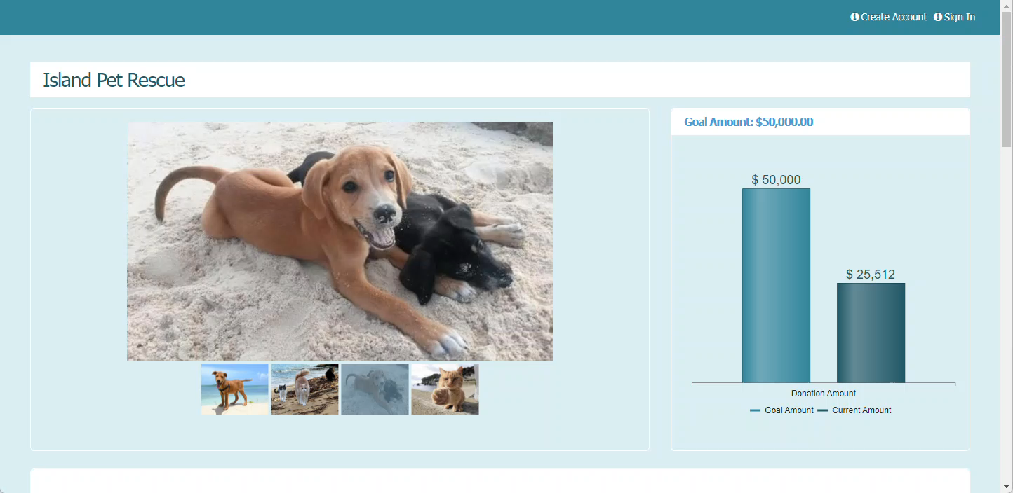

Slide 29
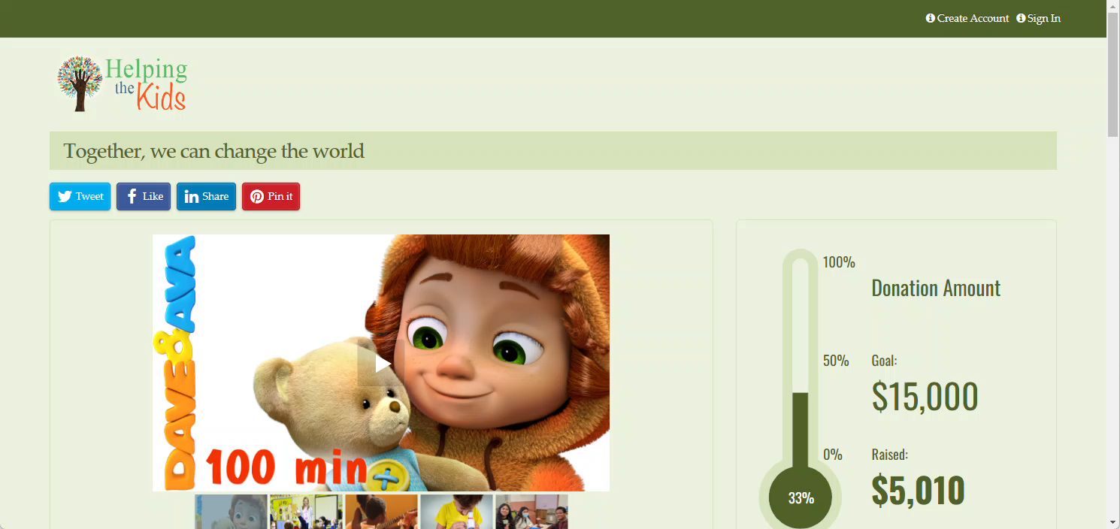

Slide 30
Credit card swiper and iPad with mobile app

Slide 31
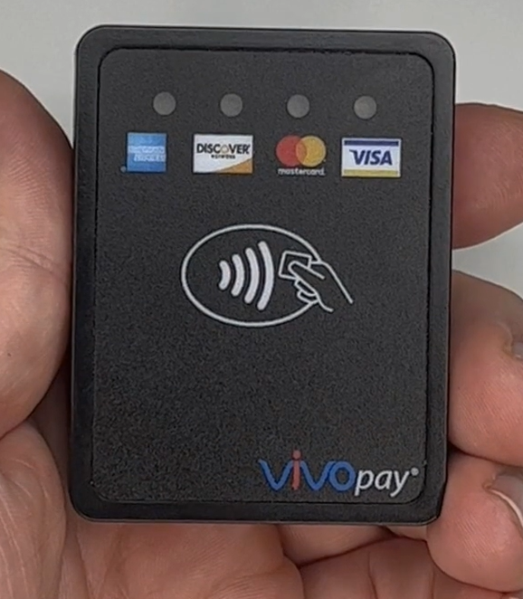

Slide 32
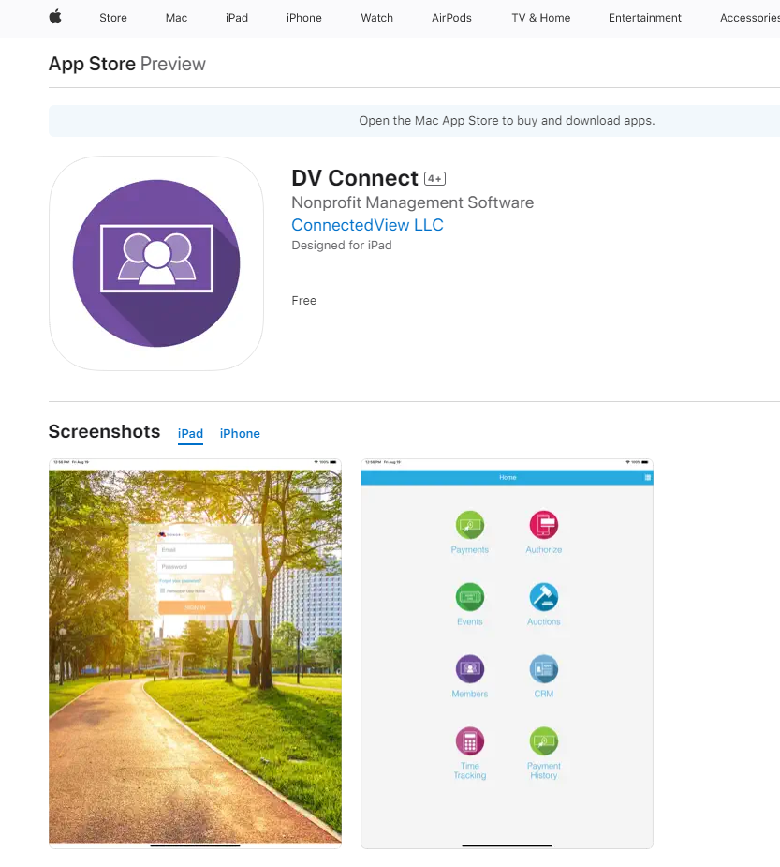

Slide 33
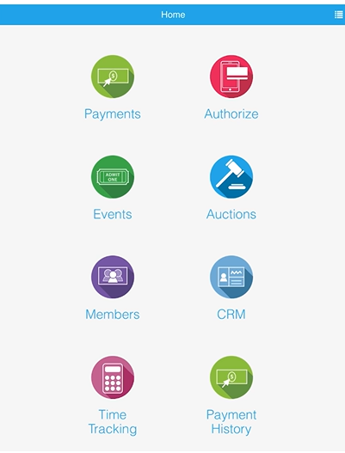

Slide 34
Text “AFP” to
508-251-8676

Slide 35
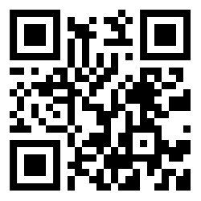
QR Codes

Slide 36
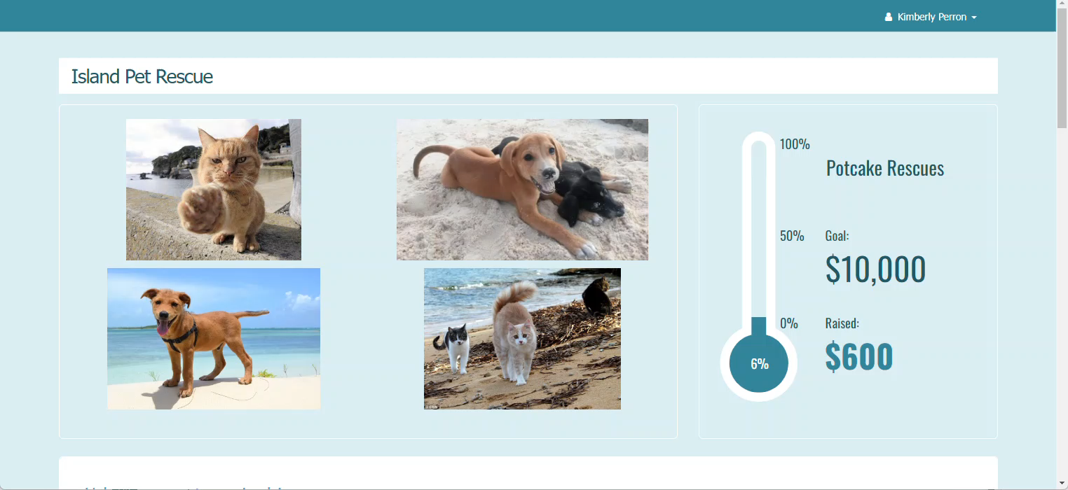

Slide 37
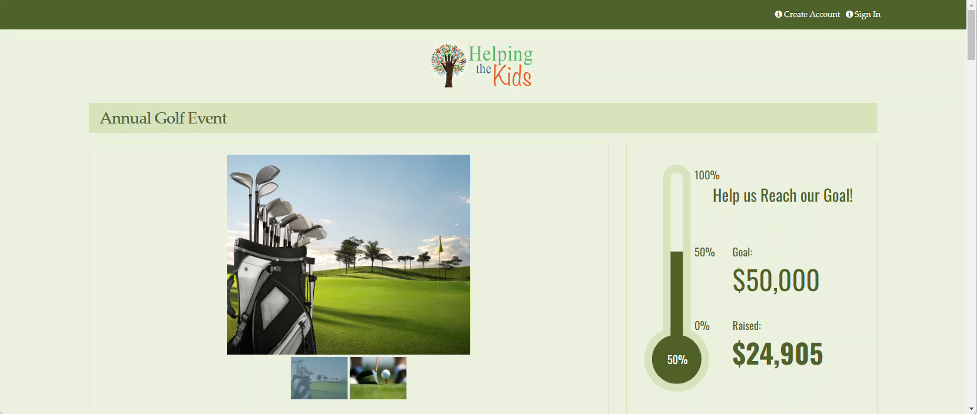

Slide 38
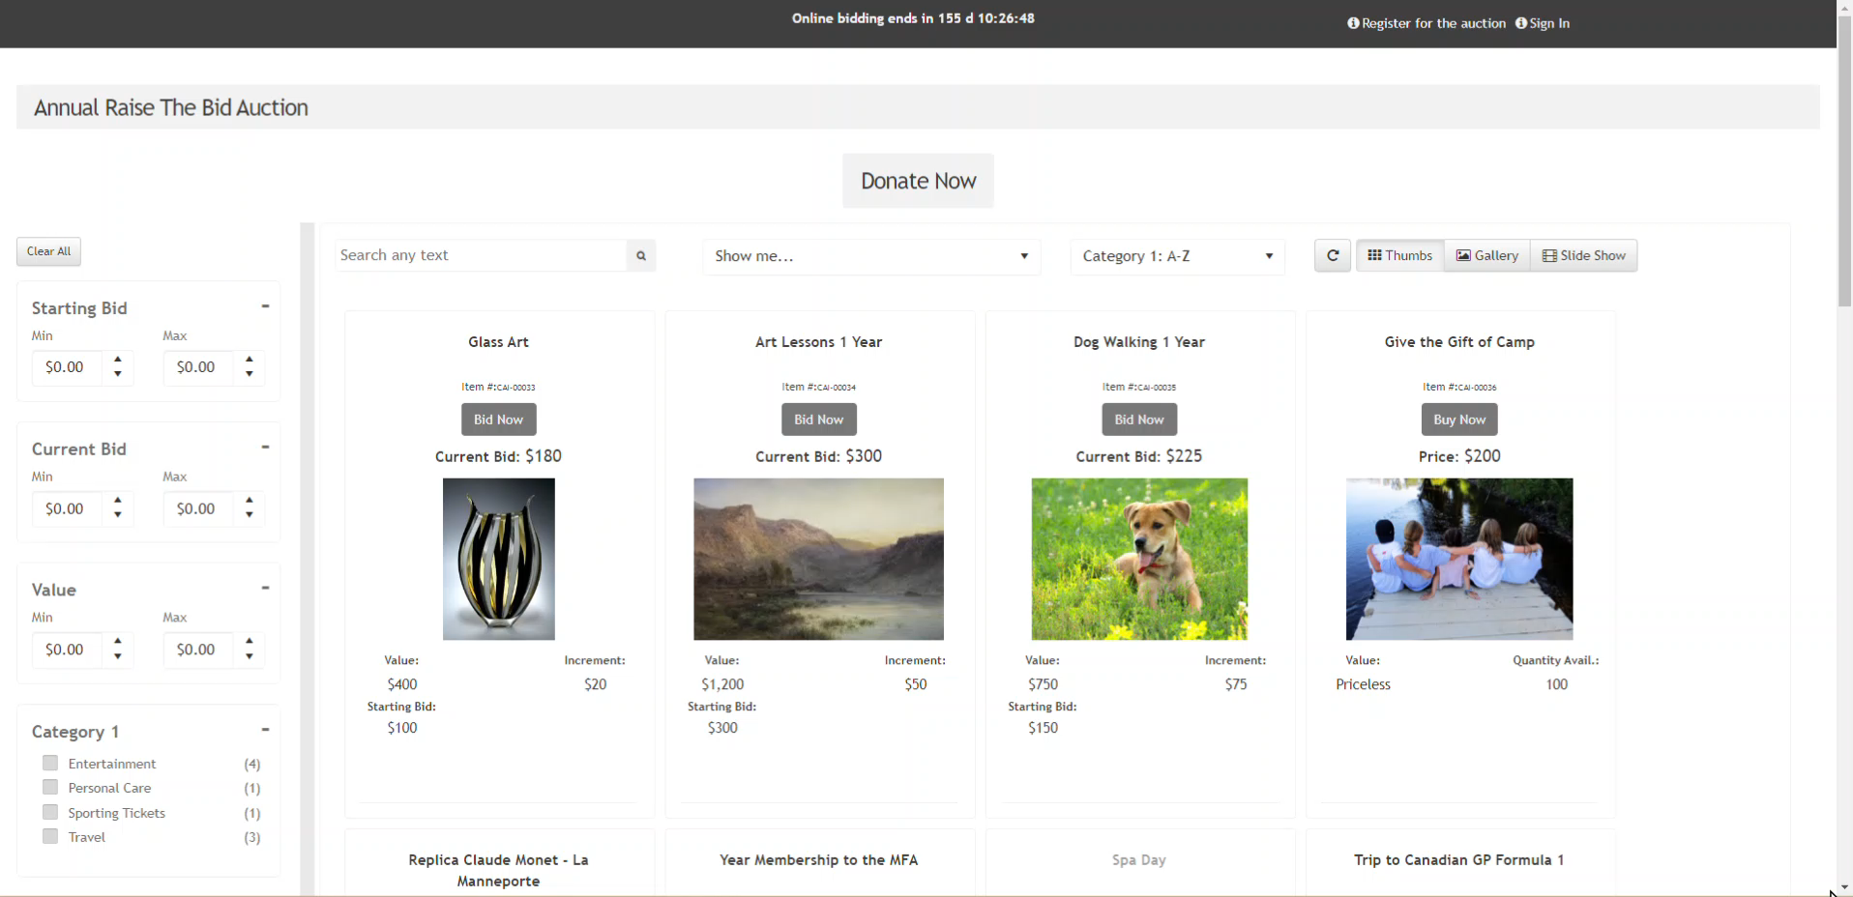

Slide 39
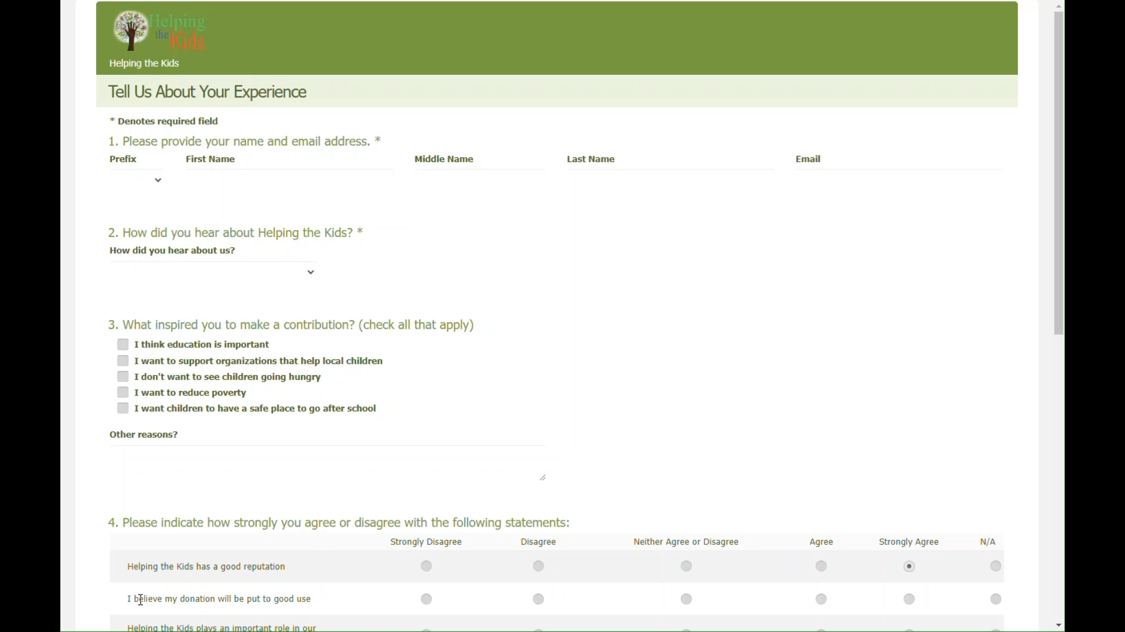

Slide 40


Slide 41
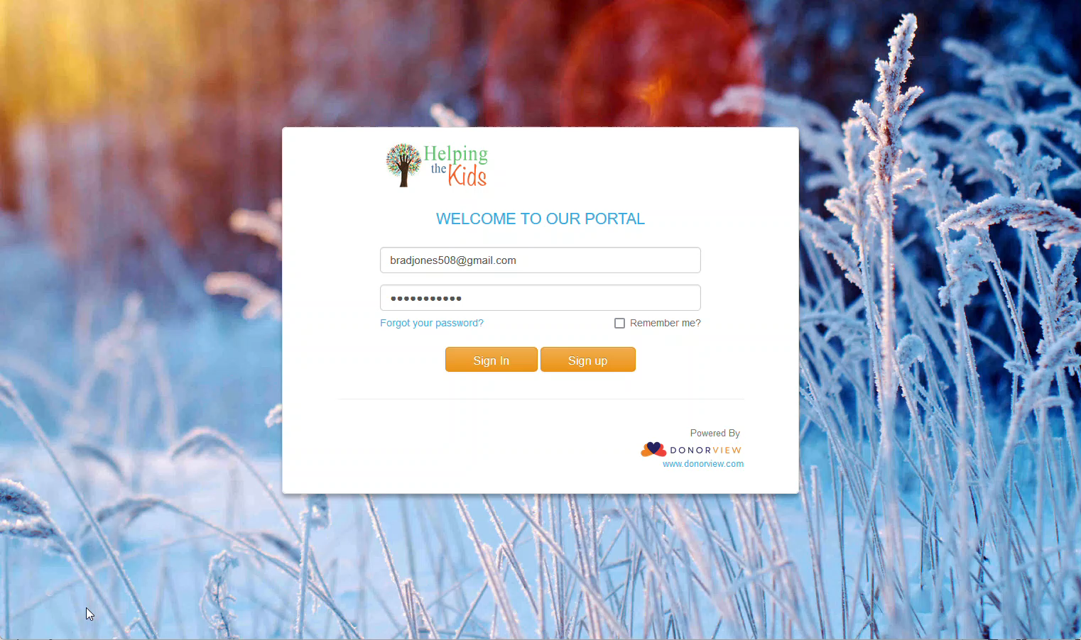

Slide 42
Contact Us
Request a Demo
508-205-0243
sales@donorview.com
donorview.com
Scan to visit our
website and set
up a demo today!
DonorView.com/Demo

